Slide 1


Airbnb Price Prediction
Group 3: Kevin Cheung, Kathy Han, Changyeol Lee, Peggy Lee, Yuqing Wang
Notes:
PEGGY

Slide 2

INTRODUCTION
BUSINESS IMPLICATION
DATASET
VISUALIZATION
PREPROCESSING
ANALYSIS
CLOSING
Executive Summary
Notes:
PEGGY

Slide 3
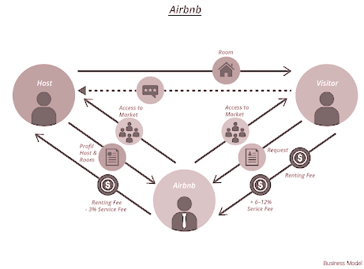
INTRODUCTION
Airbnb offers an online rental marketplace allowing travelers to book from the company’s host.
Increased demand in travelers who seeks to stay in local homes rather than traditional lodging
Notes:
PEGGY
Like many of us know, airbnb offer lodging services to traveleres like you and me who seeks to stay in a more local environment when visiting new cities or country.

Slide 4

BUSINESS IMPLICATION
Data from 2015 to 2019 shows increases in the following:
Bookings: 648%
Listing: 483%
Revenue: 522%
With increased demand, host would require a better understanding on listings pricing.
Objective: create predictive model that utilizes listing attributes for price range prediction
Notes:
PEGGY
Airbnb launched back in 2008 and there are some notable data from 2015 to 2019 that we would like to bring up. In this period there is a significant increase in 3 following major area of the company. With such a demand in the service, there would also be an increased need for host to better understand how to price their listing. Our objective is to provide a predictive model allowing all involving parties to have a better grasp of pricing.

Slide 5
DATASET SUMMARY & DESCRIPTION
74.1K instances with 29 variables
Class variable:
“log_price” → price of listing
We focused on listing in Los Angeles area.
Total Instances: 22.4k
Disregarded variables:
id, amenities, city, description, property type, first review, host since, last review, name, neighborhood, thumbnail url, zip code
Notes:
PEGGY
Used the Airbnb data from Kaggle.
29 attributes and 74.1 thousand instances.
Our class variable of interest is log_price. We discretized the attribute into high and low prices.
We are focusing Los angeles area, so we extracted listing in this from our dataset.
We also removed 12 attributes, that we dont deem as not relevant to our project
After that, the datatset we uses consist 17 attributes and about 22 thousand instances. Within the data, low prices accounts for 55% and high prices accounts for 45%.

Slide 6
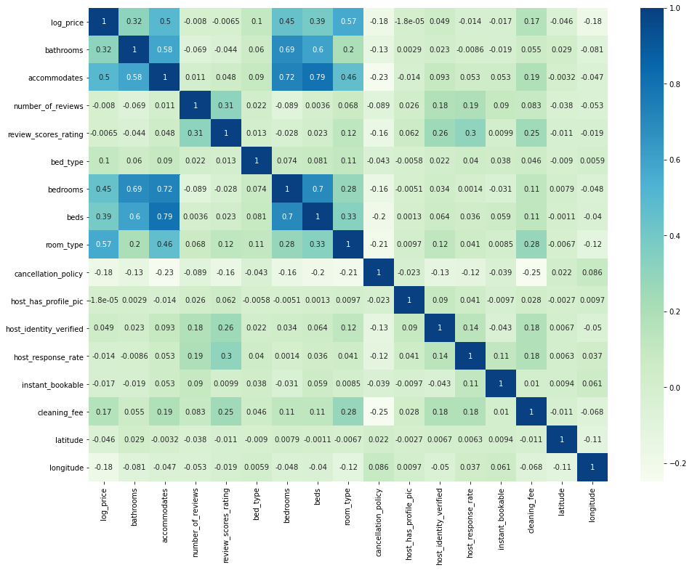
VISUALIZATION
Accommodates, bedrooms, and room type have a higher correlation with log price.

Slide 7
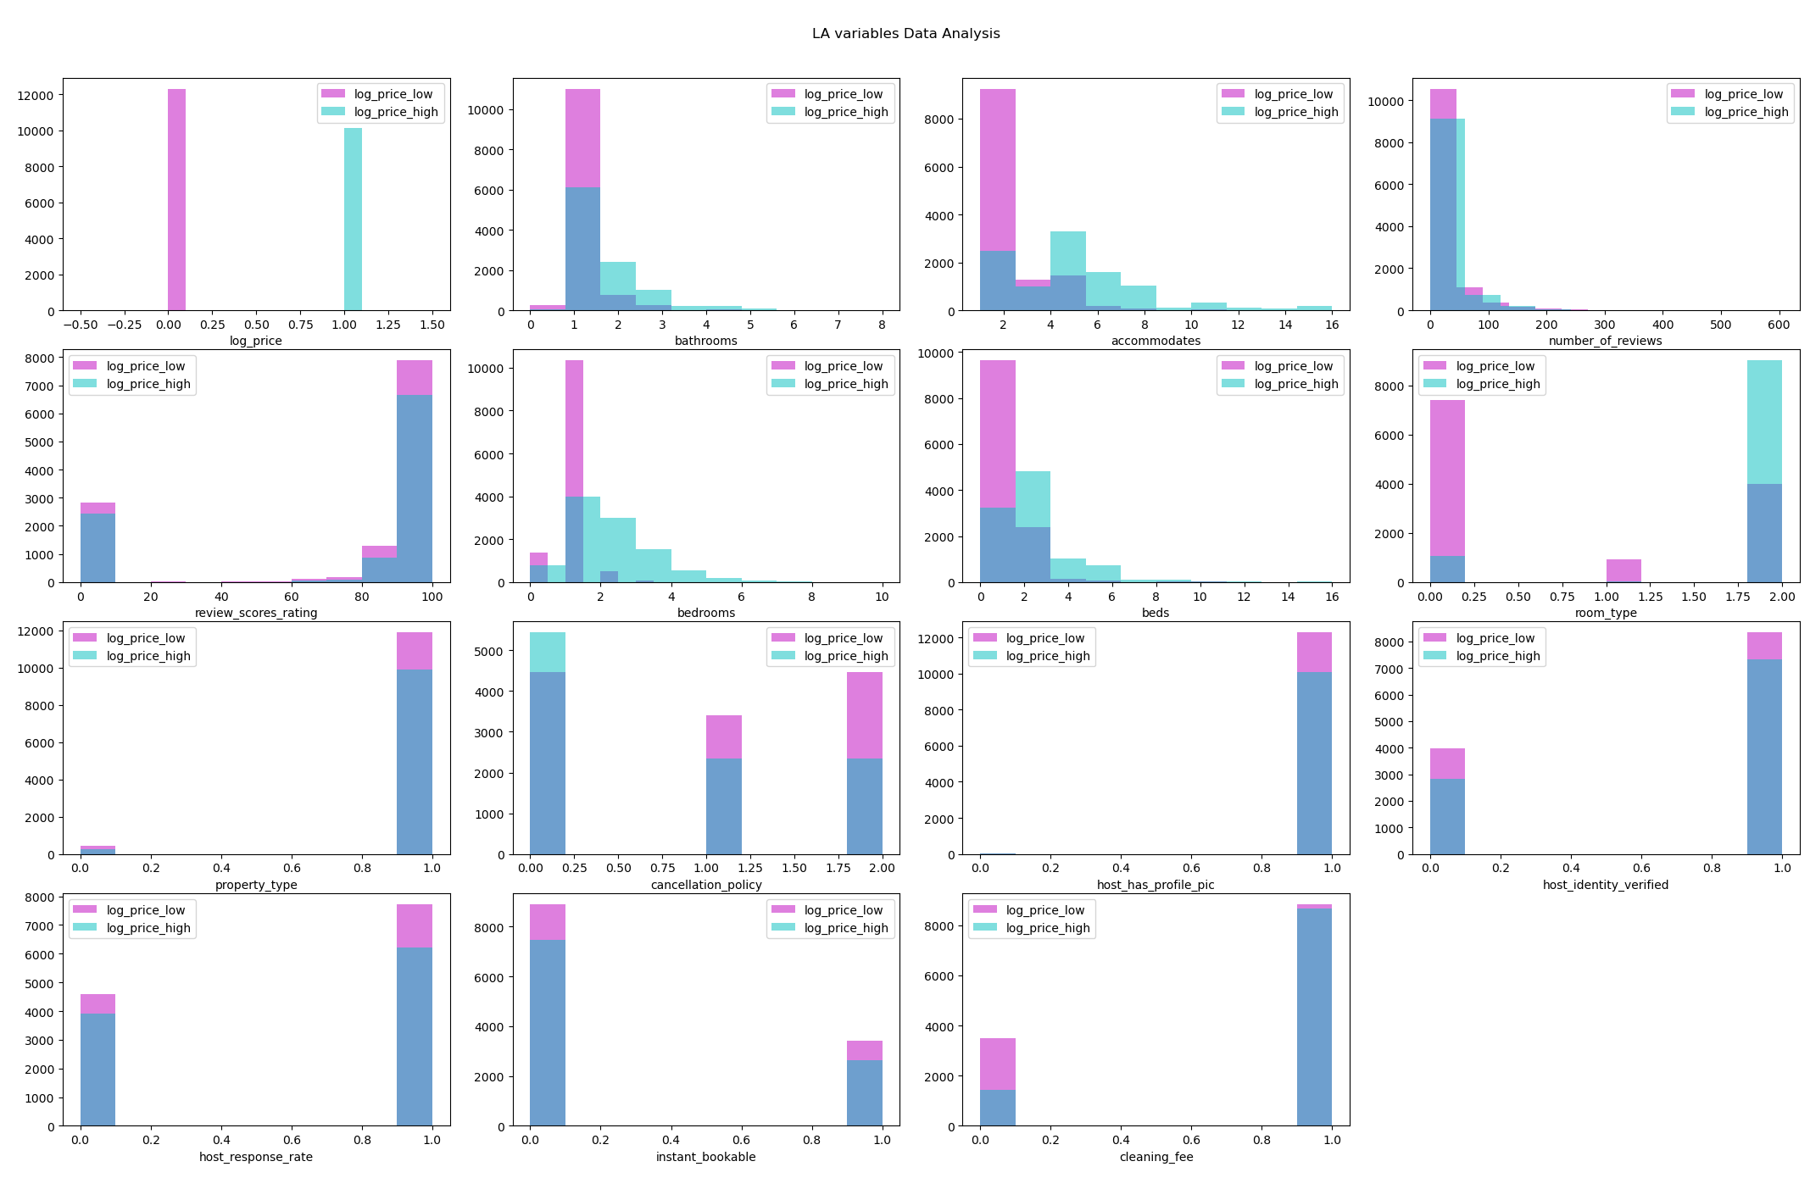
VISUALIZATION
Want to look for separateness in class variable.

Slide 8
PRE-PROCESSING
Run Benchmark model with little to no pre-processing
Set 75% threshold for Pearson correlation
Compare confusion matrices, accuracy scores, AUC, and other accuracy measures.
1
3
5
2
4
Pre-process with Filter and Wrapper methods
Remove independent variable where p > 0.05 for Sequential Backward Elimination
Notes:
We first ran model with original data to make benchmark model. After that, we used 2 methods to compare with benchmark. Which are pearson corrleation and sequential backward elimenations.
Pearson correlation finds the linear correlation between 2 variables. We needed to find which attributes were correlated to price. So we set the threshold of 75% and removed the atrributes, which were less than thresholds.
Sequential Backward elimination we start with every independent variables and remove attributes, which have p-values more than 0.05.

Slide 9
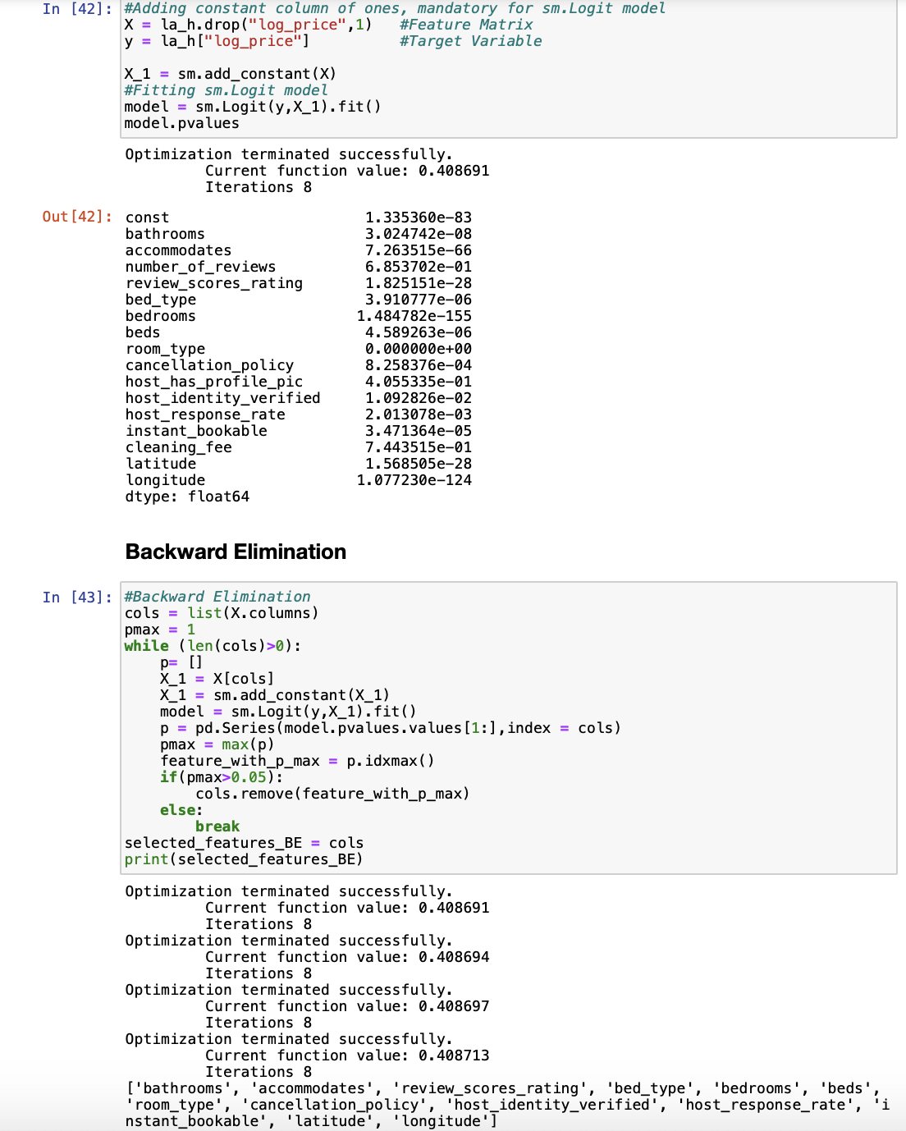
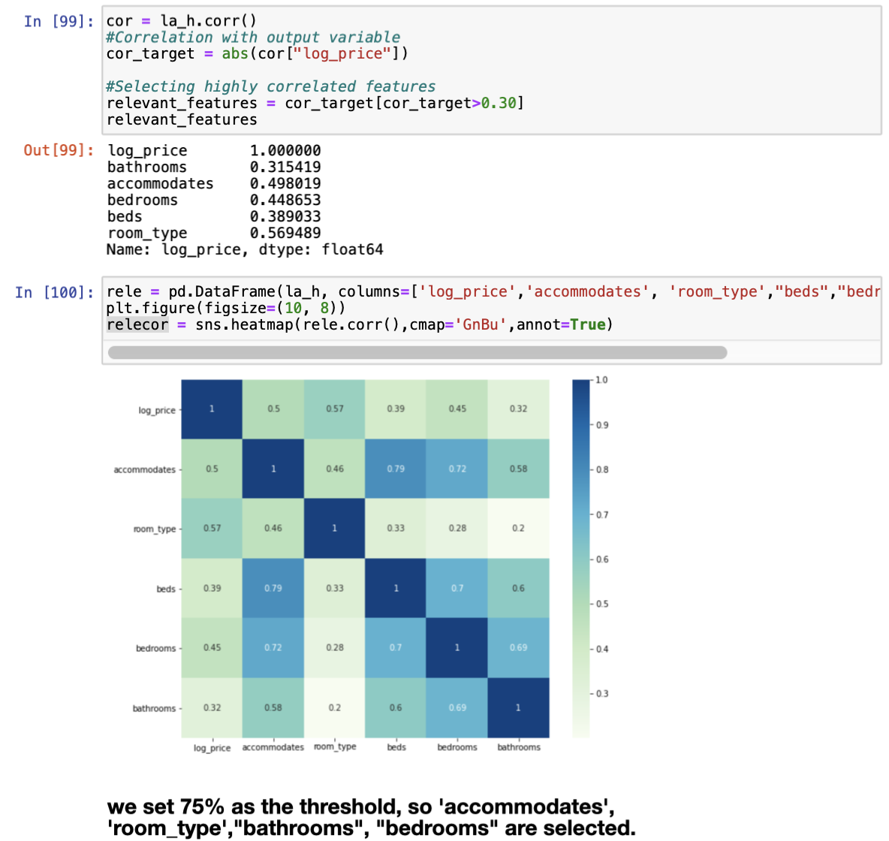
Pearson Correlation
Sequential Backward Elimination
Notes:
Left side is the codes in which we processed data through pearson correlation. We made the heatmap to find correlation beteen each attribute
Right side is the codes in which we processed data through sequential backward elmination. We were trying to find attribues, which have p-vales more than 0.05

Slide 10
ANALYSIS
Predicting prices that are considered “low” and “high” using following models:
Logistic regression
Bernoulli Naive Bayes
Random Forest
KNN
Comparison:
Training size of 70% and testing size 30%
10-Fold Cross Validation
Notes:
With the data, we used these 4 models to predict which attributes influence on prices.
Logistic regression is a statistical technique used to predict the probability of occurrence of an event using linear combinations of independent variables.
Naive Bayes is a simple machine learning technique for creating classifiers. The algorithm is trained using multiple algorithms based on general principles.
The Random Forest method is an ensemble method, which combines results from multiple trees.
K-nearest neighbors algorithm (KNN) is an algorithm that classifies data into K labels that are close to data.
And We split the data to make training set and testing set. We decided to have training of 70% and testing of 30%.

Slide 11
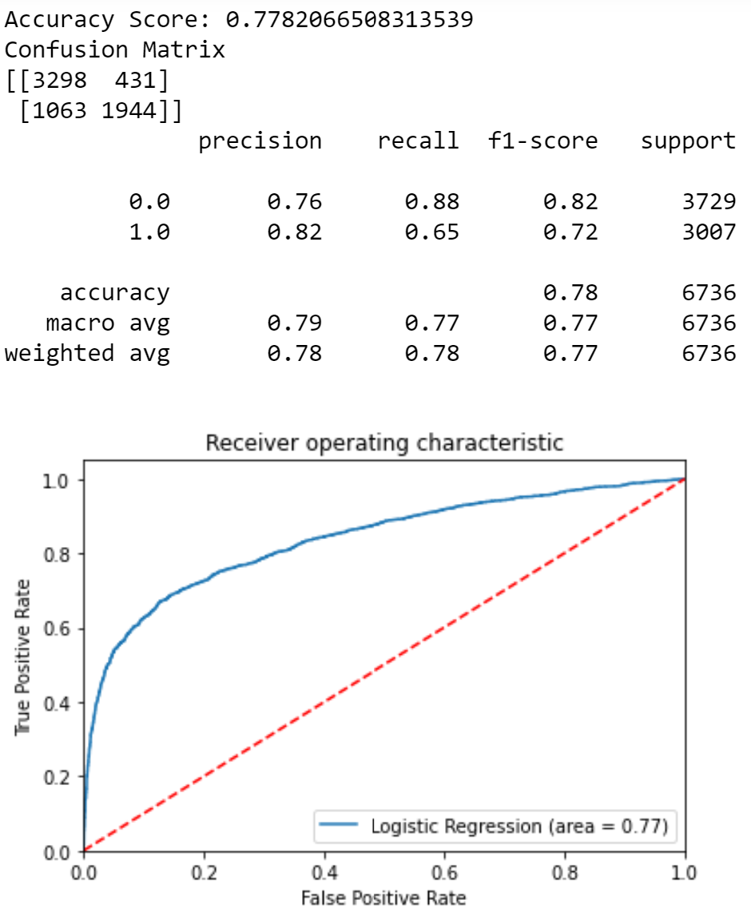
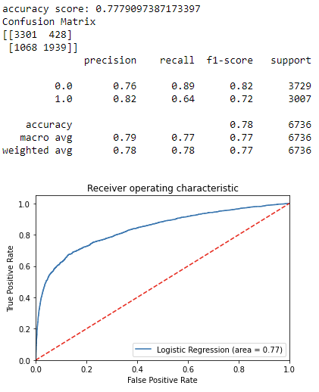
Logistic Regression
Benchmark: 0.7782
Removed bathrooms and number of reviews
Benchmark: 0.7779
Notes:
We first ran our benchmark on the Logistic regression model, and got an accuracy score of 0.78. Then within our logistic regression results, we found 2 attributes, bathrooms and number of reviews were higher than p-value of 0.05.
Therefore, we ran logistic model again after removing these 2 attributes and we got an accuracy score 0.78. Removing these two attributes did not make much of a difference as can be see in the AUC score of 0.77.

Slide 12
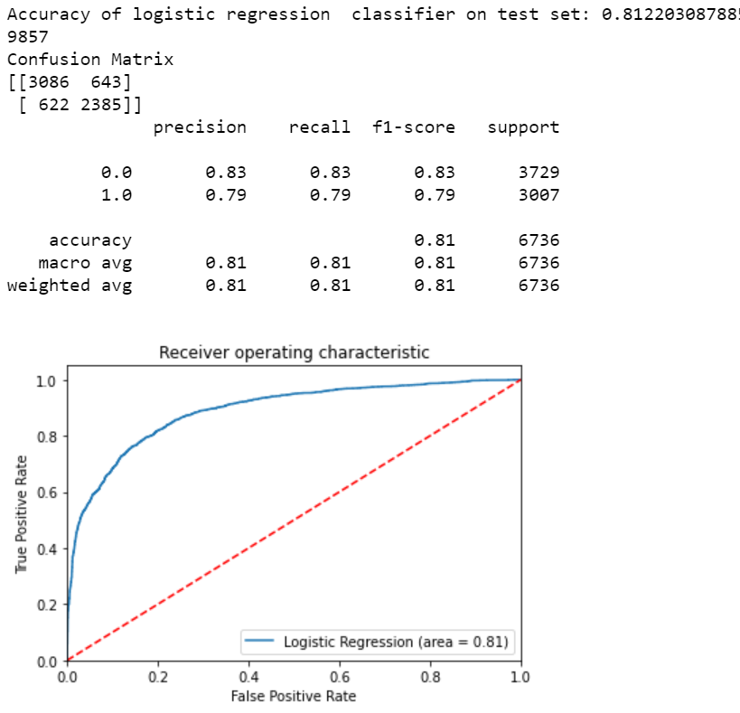
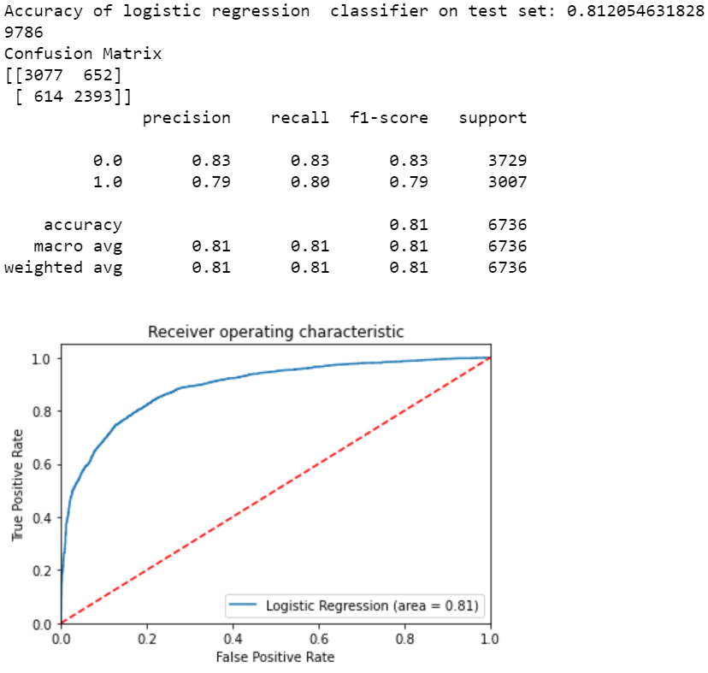
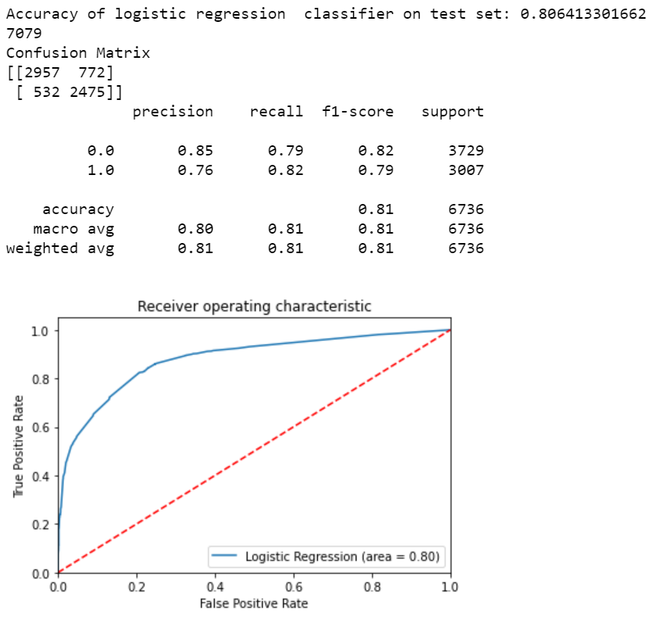
Sequential Backward Elimination: 0.8122
Sequential Backward Elimination: 0.8121
Removed host_identity_verified
Pearson Correlation: 0.8064
Notes:
Then, we ran our logistic regression model with sequential backward elimination, which gave an accuracy of 0.81. Within our logistic regression results, we found that host_identity_verfied was not significant, so we removed that attribute and re-ran the model. With the same accuracy score of 0.81. Again, nothing much as changed, the true positive increased a little, that’s why the recall increased by 0.01.
For pearson correlation, we did not find any attribute higher than 0.05, and we got an accuracy of 0.81.

Slide 13
Logistic Regression
0(Low price) | Precision | Recall | f1-score | AUC
Logistic Regression (Raw data) | 0.76 | 0.89 | 0.82 | 0.77
Logistic Regression (Raw data without bathrooms and number of reviews) | 0.76 | 0.88 | 0.82 | 0.77
Logistic Regression (Backward Elimination) | 0.83 | 0.83 | 0.83 | 0.81
Logistic Regression (Backward Elimination without host_identity_verified) | 0.83 | 0.83 | 0.83 | 0.81
Logistic Regression (Pearson Correlation) | 0.85 | 0.79 | 0.82 | 0.80
1(High price) | Precision | Recall | f1-score | AUC
Logistic Regression (Raw data) | 0.82 | 0.64 | 0.72 | 0.77
Logistic Regression (Raw data without bathrooms and number of reviews) | 0.82 | 0.65 | 0.72 | 0.77
Logistic Regression (Backward Elimination) | 0.79 | 0.79 | 0.79 | 0.81
Logistic Regression (Backward Elimination without host_identity_verified) | 0.79 | 0.80 | 0.79 | 0.81
Logistic Regression (Pearson Correlation) | 0.76 | 0.82 | 0.79 | 0.80
Notes:
Here we combined all the performance results and found that backward elimination was the better technique to use in running logistic regression as the AUC is the highest.
The Area Under the Curve (AUC) tells us how much the model is able to differentiate between classes - the higher the AUC, the better the model - and is used as a summary of the ROC curve.
Precision talks about how precise our model is out of the total predicted positives. Recall talks about how many of the actual positives are captured in the model.
F1-score seeks to find a middle ground between precision and accuracy. A good f1-score means that the model has low false positives and low false negatives.
For price low, pearson correlation has the most precise prediction (Most scores are high, pearson has the highest on precision)
For price high, backward elimination after removing the attribute(host_identity_verfied) has the most precise prediction (In particular, f1-score and AUC has the highest score)

Slide 14
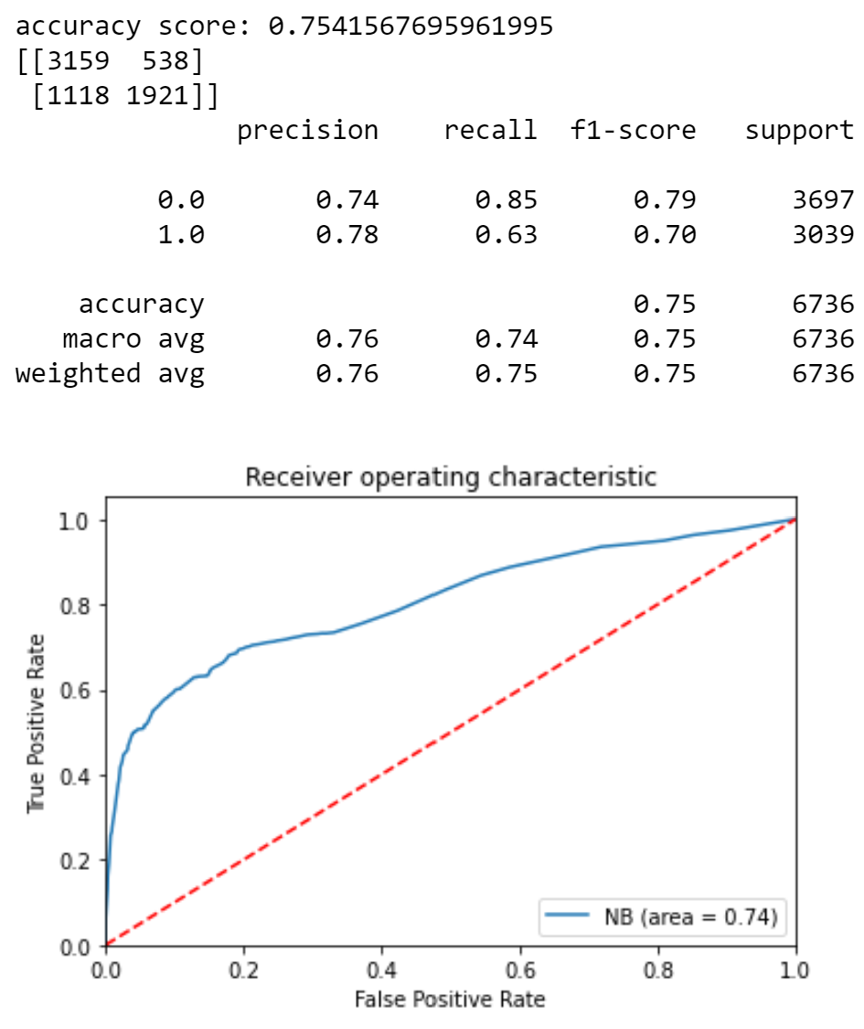
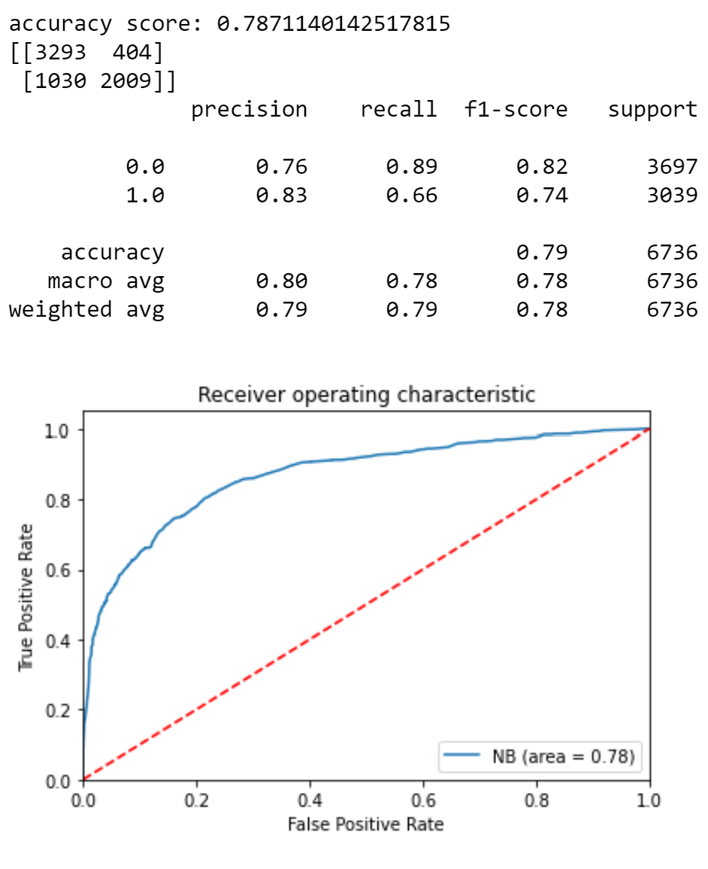
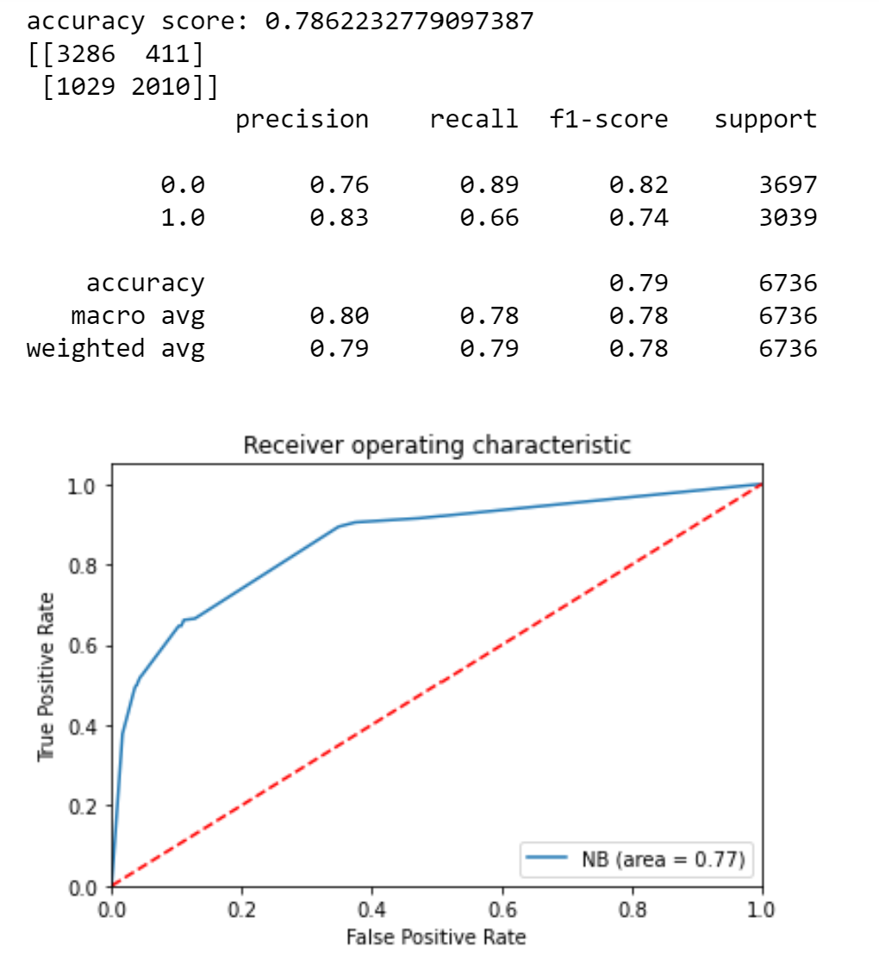
Naive Bayes
Benchmark: 0.7541
Backwards elimination: 0.7871
Pearson Correlation: 0.7862
Notes:
We also ran Naive Bayes on the benchmark with an accuracy of 75%, backwards elimination with a 78.7% accuracy and pearson correlation with 78.6%.
Both of these models beat the benchmark model.

Slide 15
Naive Bayes
0(Low price) | Precision | Recall | f1-score | AUC
Naive Bayes (Raw data) | 0.74 | 0.85 | 0.79 | 0.74
Naive Bayes (Backward Elimination) | 0.76 | 0.89 | 0.82 | 0.78
Naive Bayes (Pearson Correlation) | 0.76 | 0.89 | 0.82 | 0.77
1(High price) | Precision | Recall | f1-score | AUC
Naive Bayes (Raw data) | 0.78 | 0.63 | 0.70 | 0.74
Naive Bayes (Backward Elimination) | 0.83 | 0.66 | 0.74 | 0.78
Naive Bayes (Pearson Correlation) | 0.83 | 0.66 | 0.74 | 0.77
Notes:
Backward Elimination has the best prediction on both price low and high. (scores are generally the highest across every metric)

Slide 16
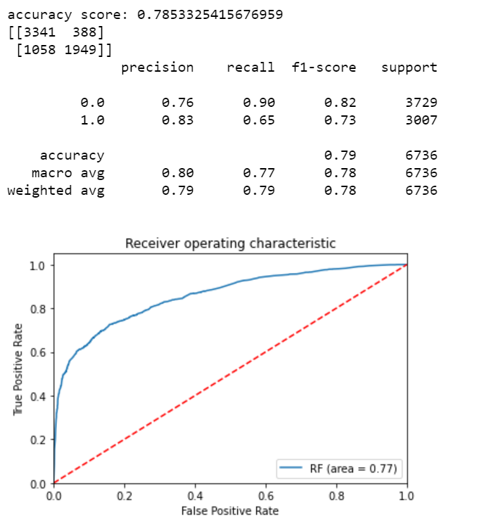
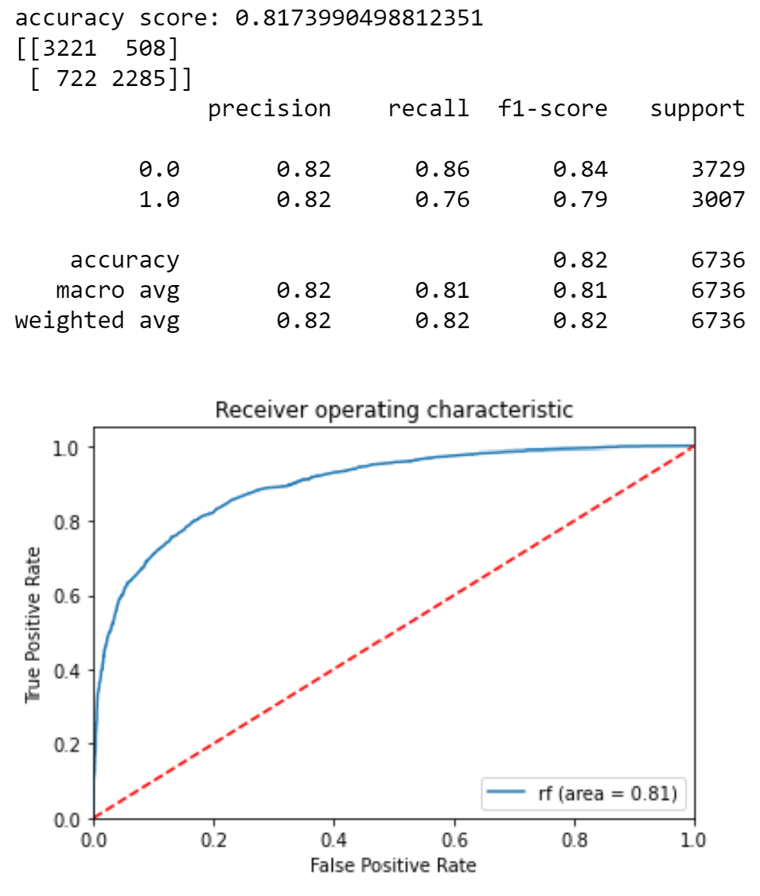
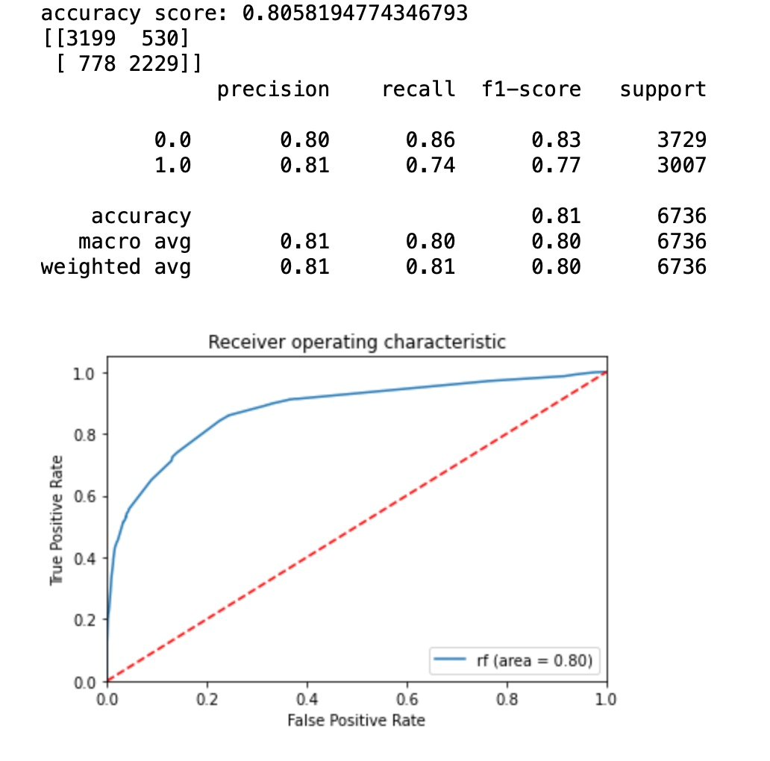
Random Forest
Backwards Elimination
Pearson Correlation
Benchmark
AUC=0.77
AUC=0.81
AUC=0.80
Notes:
Compare the Area Under Curve for all three model,the higher the AUC, the better the model is at distinguishing between high and low log_price.As result we can see the backward elimination has the best improvement of auc.
=====
next slide please

Slide 17
Random Forest
This ensemble model combines results from multiple trees.
0 (Low price) | Precision | Recall | f1-score | Accuracy
Random Forest (Raw data) | 0.76 | 0.90 | 0.82 | 0.785
Random Forest (Backward Elimination) | 0.82 | 0.86 | 0.84 | 0.817
Random Forest (Pearson Correlation) | 0.80 | 0.86 | 0.83 | 0.806
1(High price) | Precision | Recall | f1-score | Accuracy
Random Forest (Raw data) | 0.83 | 0.65 | 0.73 | 0.785
Random Forest (Backward Elimination) | 0.82 | 0.76 | 0.79 | 0.817
Random Forest (Pearson Correlation) | 0.81 | 0.74 | 0.77 | 0.806
Notes:
Nest, we have random forest
Testing our benchmark with random forest, we observed that the overall accuracy score of this model was 0.785
So we tried the other two method to improve the accuracy of our random forest prediction on log price.
Overall accuracy score of random forest goes up to 0.817 by using backward elimination
After running the Random Forest model with pearson correlation, our model had an accuracy of 0.806
Comparing these two technique, we know that Backward Elimination has the best prediction on our class variable on both price low and high
next slide please

Slide 18
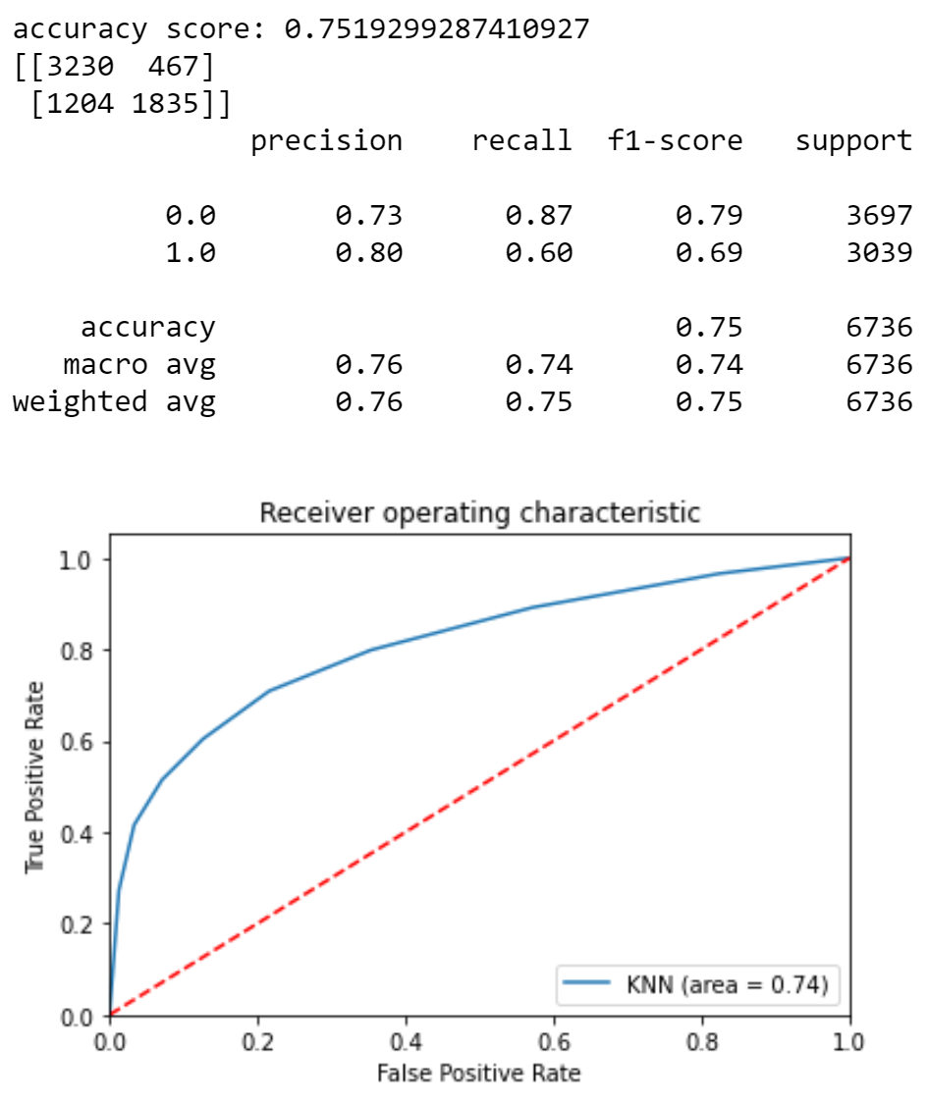
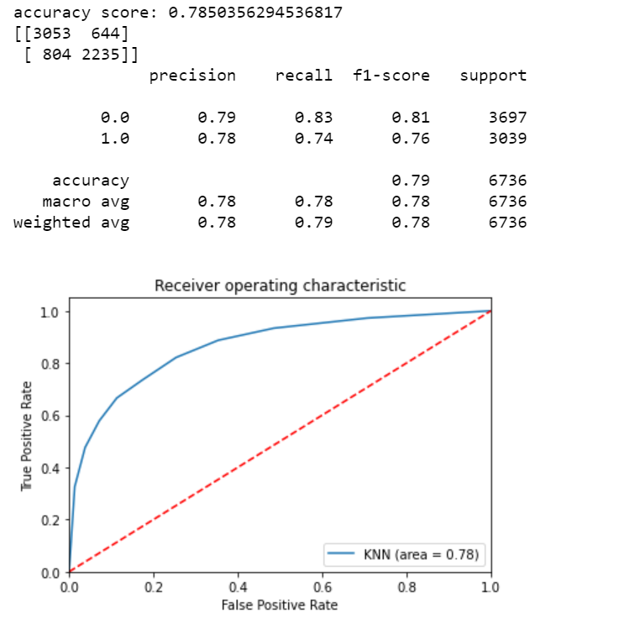
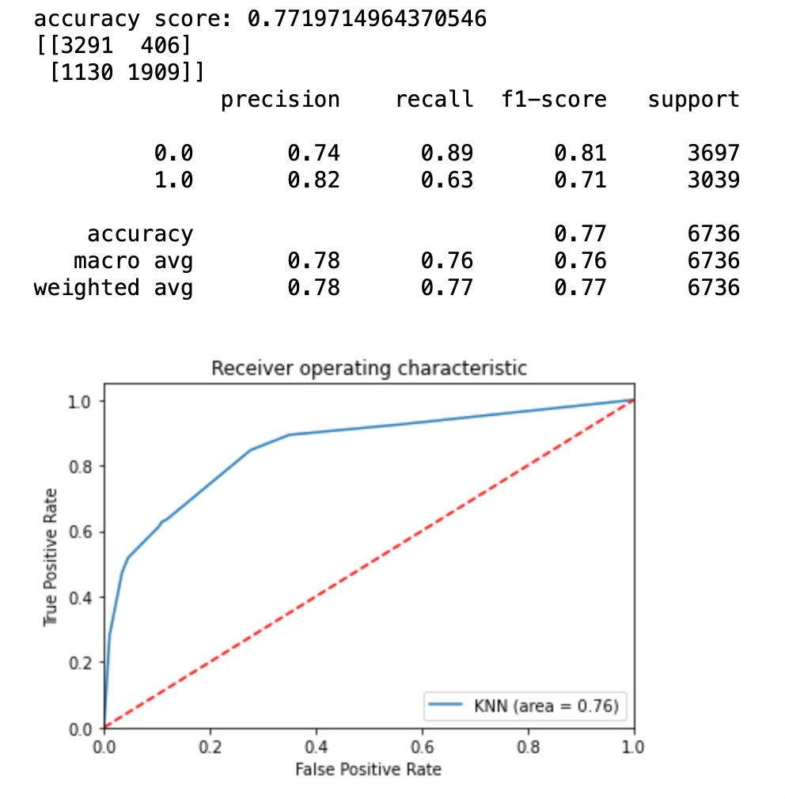
KNN
Backwards Elimination
Pearson Correlation
Benchmark
AUC=0.74
AUC=0.78
AUC=0.76
Notes:
Here are the 3 model comparison on KNN.
As the result shows above, we can see the backward elimination has the best improvement of auc.
=====
next slide please

Slide 19
KNN
0(Low price) | Precision | Recall | f1-score | Accuracy
KNN (Raw data) | 0.73 | 0.87 | 0.79 | 0.78
KNN (Backward Elimination) | 0.79 | 0.83 | 0.81 | 0.81
KNN (Pearson Correlation) | 0.74 | 0.89 | 0.81 | 0.77
1(High price) | Precision | Recall | f1-score | Accuracy
KNN (Raw data) | 0.81 | 0.68 | 0.74 | 0.78
KNN (Backward Elimination) | 0.81 | 0.77 | 0.79 | 0.81
KNN (Pearson Correlation) | 0.76 | 0.72 | 0.74 | 0.77
Notes:
Backward elimination predicts the most on both price low and high. (For low price, Backward elimination has the highest scores except recall. Although recall value is high enough. For high price, backward elimination has the highest scores except precision. But that doesn’t mean precision has a low score)
Testing our benchmark with KNN, we observed that the overall accuracy score was 0.75
running KNN with sequential backward elimination, the accuracy score of this model was 0.78,
running KNN model with pearson correlation, our model had an accuracy of 0.77
When comparing Pearson correlation with the benchmark, the accuracy improved by about 2%.
however, backward elimination with the benchmark, the accuracy improved by about 3%.
===
next slide please

Slide 20
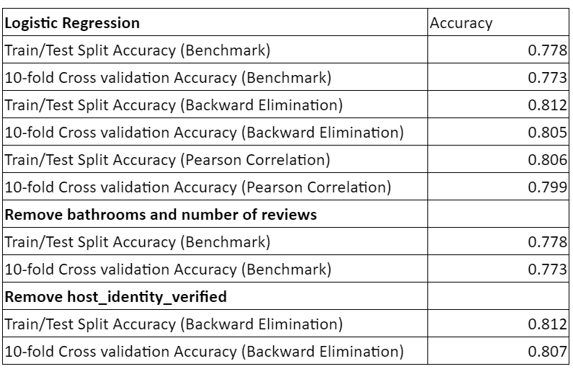
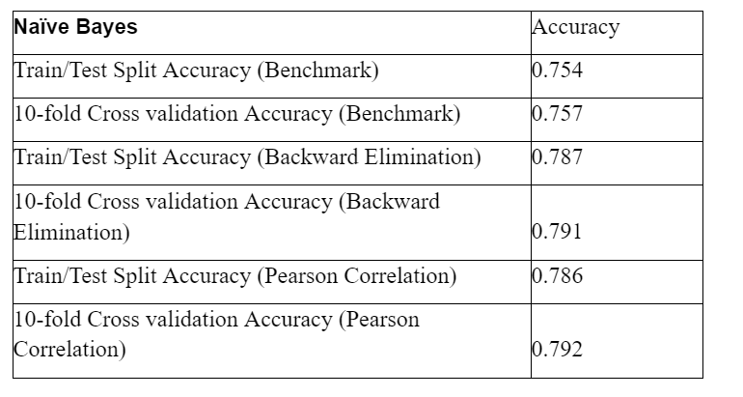
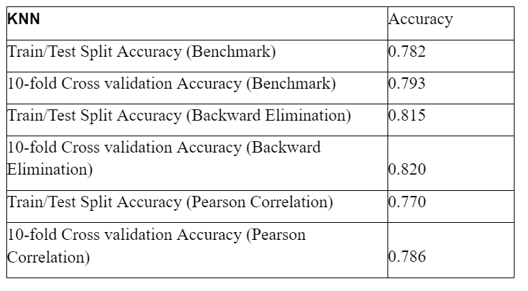
10-Fold Cross Validation vs Train & Test Split
10-Fold Cross Validation and Train-Test Split had fairly similar accuracies within benchmark, backward elimination, and pearson correlation.

Slide 21
Conclusion
Sequential Backward Elimination and Pearson Correlation beats the benchmark performance across all models
Random Forest model and Logistic Regression model showed better performance scores
78 - 80% accuracy to predict listing whether the price is low or high for a listing in the Los Angeles area
Airbnb can utilize this information to gain more profit
Notes:
From the 4 models and 2 feature selection techniques that we have done, we saw that sequential backward elimination and pearson correlation beats the benchmark performance across all the models.
Random forest and logistic regression models showed better performance scores.
Our accuracies were around 78-80% in predicting whether the price is low or high for a listing in the los angeles area.
However this can be improved by analyzing different cities dataset around the world to see what other attributes have an effect on pricing.
Finally, Airbnb can discern which areas have these specific attributes that affect price, and market to properties in these regions to become hosts, therefore gaining a bigger profit from high priced listings.
Tank you And now we will move on to Q&A.

Slide 22
THANK
YOU

Slide 23

Q&A

